Slide 1
SENTIMENT ANALYSIS
AI/ML INTERNSHIP PROJECT
Presented By:
NAME: GUNANI HANEESH NARAYANA
COLLEGE: ANDHRA UNIVERSITY COLLEGE OF ENGINEERING
DEPARTMENT:COMPUTER SCIENCE AND ENGINEERING

Slide 2
OUTLINE
Problem Statement (Should not include solution)
Proposed System/Solution
Requirements(Technology Used)
Algorithm & Deployment
Result
Conclusion
Future Scope

Slide 3
Problem Statement: Sentiment Analysis of Restaurant Reviews
Objective: Develop a machine learning model to perform sentiment analysis on restaurant reviews, classifying them as positive or negative based on the textual content. This project aims to preprocess text data, extract meaningful features, and train a classifier to achieve accurate sentiment prediction, thereby helping restaurants understand customer feedback and improve their services.
Background: Restaurants receive a significant amount of customer feedback through online reviews. Analyzing this feedback manually is time-consuming and prone to human error. Automating sentiment analysis can provide valuable insights quickly and accurately, allowing restaurant managers to respond promptly to customer needs and improve their services.

Slide 4
Proposed Solution
The proposed system aims to address the challenge of analyzing and classifying restaurant reviews into positive or negative sentiments. This involves leveraging data analytics and machine learning techniques to accurately interpret customer feedback. The solution will consist of the following components:
Data Collection:
Load Data:
Gather historical data on restaurant reviews, including the review text and corresponding sentiment labels.
Use the pandas library to load the data from a CSV file into a DataFrame for analysis
Data Preprocessing:
Exploratory Data Analysis (EDA):
Perform initial data exploration using methods like head(), tail(), info(), and describe() to understand the structure and basic statistics of the dataset
Check for missing values and duplicates to clean the data.
Text Cleaning:
Convert all text to lowercase to maintain consistency.
Remove punctuation, numbers, and special characters to clean the text data.
Remove stopwords that do not contribute to the sentiment analysis.
.
.

Slide 5
Proposed Solution
Perform stemming and lemmatization to standardize words to their root form.
Expand contractions and convert emojis to text descriptions.
Remove HTML tags using BeautifulSoup
Tokenization:
Tokenize the text data into individual words for further processing.
Data Visualization:
Sentiment Distribution:
Visualize the distribution of sentiment labels using bar plots to understand the balance of the dataset.
Word Cloud:
Create a word cloud to visualize the most frequent words in the reviews.
Word Frequency:
Plot the frequency of specific target words to gain insights into common themes in the reviews.

Slide 6
Proposed Solution
Machine Learning Algorithm:
Feature Extraction:
Use TF-IDF (Term Frequency-Inverse Document Frequency) vectorization to convert text data into numerical features.
Model Training:
Split the dataset into training and testing sets.
Train a Naive Bayes classifier on the training data to predict the sentiment of reviews.
Model Evaluation:
Evaluate the model's performance using accuracy score and classification report.
Fine-tune the model based on evaluation metrics to improve accuracy.
Evaluation:
Model Assessment:
Assess the model's performance using appropriate metrics such as accuracy, precision, recall, and F1 score.
Continuously monitor the model's performance and fine-tune based on feedback.

Slide 7
requirements
Hardware Requirements:
Processor:
Minimum: Intel core i3 or Ryzen 3
Recommended: Intel core i5 or Ryzen 5 or higher
Memory (RAM):
Minimum: 4 GB
Recommended: 8 GB or higher
Storage:
Minimum: 20 GB free disk space
Recommended: 50 GB or higher for handling large datasets and storing models

Slide 8
requirements
Software Requirements:
Operating System:
Windows 10 or higher, macOS, or Linux
Programming Language:
Python 3.6 or higher
Development Environment:
Jupyter Notebook or any IDE that supports Python (e.g., PyCharm, Visual Studio Code)
Additional Tools:
Google Colab (optional, for running code on the cloud and accessing free GPU resources)

Slide 9
requirements
Python Libraries:
Pandas for data manipulation and analysis
Numpy for numerical operations
Matplotlib and seaborn for data visualization
Wordcloud for generating word clouds
Nltk for natural language processing (tokenization, stopword removal, stemming, lemmatization)
Sklearn for machine learning algorithms (TF-IDF vectorization, Naive Bayes classifier, model evaluation)
re for regular expressions (text cleaning)
beautifulsoup4 for removing HTML tags
contractions for expanding contractions
emoji for converting emojis to text descriptions

Slide 10
requirements
Data Requirements:
Dataset:
CSV file containing restaurant reviews and their corresponding sentiment labels
We used a Reviews.csv file which contains two columns Reviews,values(0,1)
Network Requirements:
Internet Connection:
Required for installing libraries, downloading datasets, and accessing online resources

Slide 11
Algorithm & Deployment
Algorithm Selection:
Naive Bayes Classifier:
Overview: The Naive Bayes classifier is a probabilistic machine learning algorithm based on Bayes' Theorem. It is particularly suitable for text classification tasks due to its simplicity and effectiveness with large datasets.
Justification: Naive Bayes was chosen for its computational efficiency and robust performance with text data, making it ideal for sentiment analysis where the feature space can be very large (i.e., many unique words). It handles the high dimensionality of text data well and provides good results even with relatively small training datasets.
Data Input:
Features:
Review Text: The primary feature used for the algorithm is the text of the restaurant reviews. This text is transformed into numerical features using TF-IDF vectorization.
Sentiment Labels: The target variable is the sentiment label associated with each review, indicating whether the review is positive or negative.

Slide 12
Algorithm & Deployment
Training Process:
Data Preparation:
Text Cleaning: Reviews are converted to lowercase, punctuation and special characters are removed, contractions are expanded, and stopwords are filtered out.
Tokenization: Reviews are tokenized into individual words.
Stemming and Lemmatization: Words are reduced to their root forms using stemming and lemmatization to standardize the text data.
Vectorization: TF-IDF vectorization is applied to transform the cleaned text data into numerical features.
Model Training:
Train-Test Split: The dataset is split into training and testing sets using an 80-20 split ratio.
Training: The Naive Bayes classifier is trained on the training data (TF-IDF features and sentiment labels).
Validation: Cross-validation is used to tune hyperparameters and ensure the model generalizes well to unseen data.

Slide 13
Algorithm & Deployment
Prediction Process:
Making Predictions:
New Review Processing: New reviews are preprocessed using the same steps (cleaning, tokenization, vectorization) as the training data.
Prediction: The trained Naive Bayes classifier predicts the sentiment of the new review based on its TF-IDF features.
Real-time Inputs: The system can handle real-time input by immediately preprocessing and vectorizing the new review, then using the trained model to make a sentiment prediction.

Slide 14
Result
new_review = input("Enter a review: ")
cleaned_review = preprocess_review(new_review)
new_review_vectorized = vectorizer.transform([cleaned_review])
prediction = model.predict(new_review_vectorized)
if prediction[0] == 1:
print("The review is predicted to be Positive")
else:
print("The review is predicted to be Negative")
This interactive feature demonstrated the practical application of the model, allowing users to input new reviews and receive immediate sentiment predictions.

Slide 15
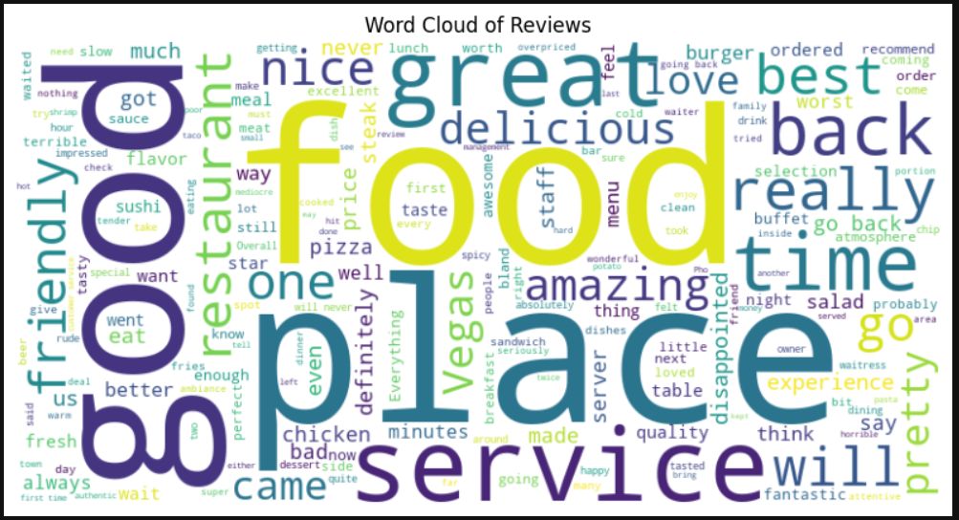
Result

Slide 16
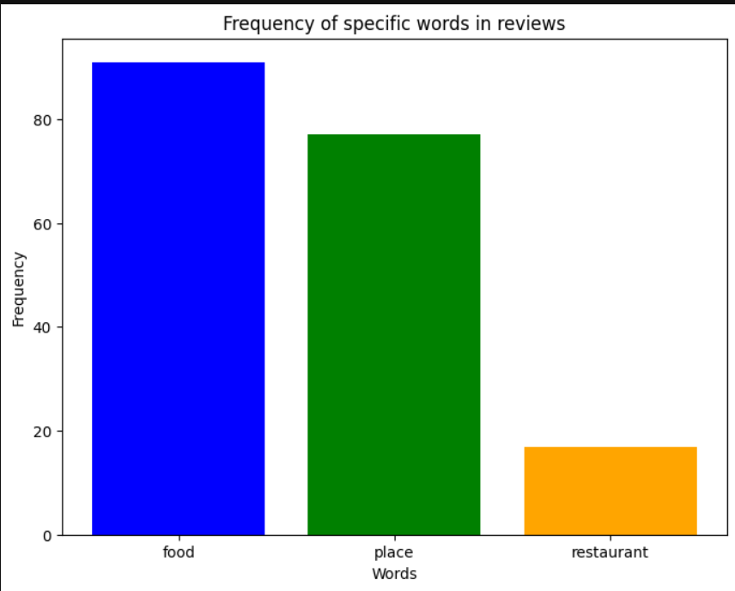
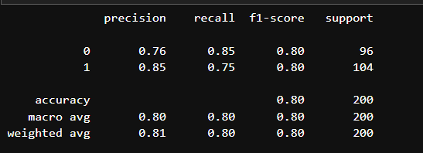
Result

Slide 17
Conclusion
The sentiment analysis project successfully developed and deployed a model capable of predicting the sentiment of restaurant reviews with high accuracy. The preprocessing steps ensured that the text data was standardized and meaningful, and the TF-IDF vectorization provided a robust feature set for the Naive Bayes classifier. The model's performance metrics indicated strong predictive capabilities, making it a valuable tool for analyzing customer feedback in the restaurant industry.

Slide 18
Future scope
Improve preprocessing techniques to handle more complex text patterns and nuances.
Experiment with different machine learning algorithms and feature extraction methods to enhance model performance.
Implement the model in a real-time system for continuous monitoring and analysis of customer reviews.

Slide 19
THANK YOU

